Slide 1
Location Analysis for Restaurant in Singapore
Prepared By : Tan Yong Sin
Prepared Date : 25th May 2020

Slide 2
Importance of a Good Location
Factors required to open a Restaurant, other having good food and chef.
Although not related to food, location is never being neglected.
Prime location is deemed such importance as it guarantees the entrepreneur one less factor to worry about: Customer Traffic
How many will visit a restaurant if it is so hard to reach? Why let the customer worry about how to go to your restaurant?

Slide 3
Data Acquisition and Cleaning
Restaurant, Shops & Services, Offices, Entertainment location and category from Foursquare
Singapore population by types of dwelling at each area.
Singapore planning area, Singapore MRT & LRT data Coordinates
Duplicated, Wrongly categorized, Non-existent Shops are corrected.
Grouped and updated their planning area for further analysis.

Slide 4
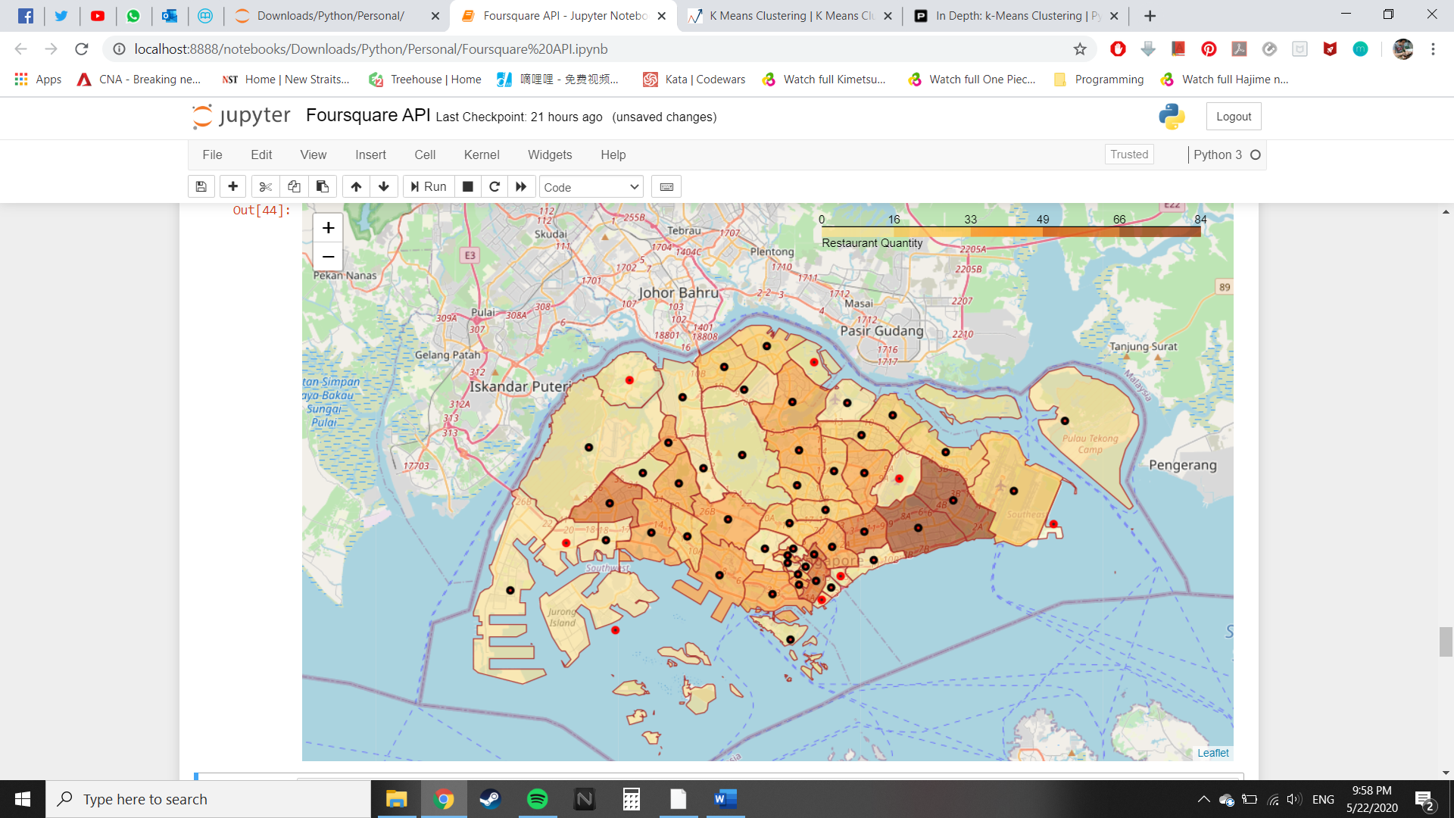
Using Choropleth mapping for Visualization
7 of top 10 areas with restaurant are in this area

Slide 5
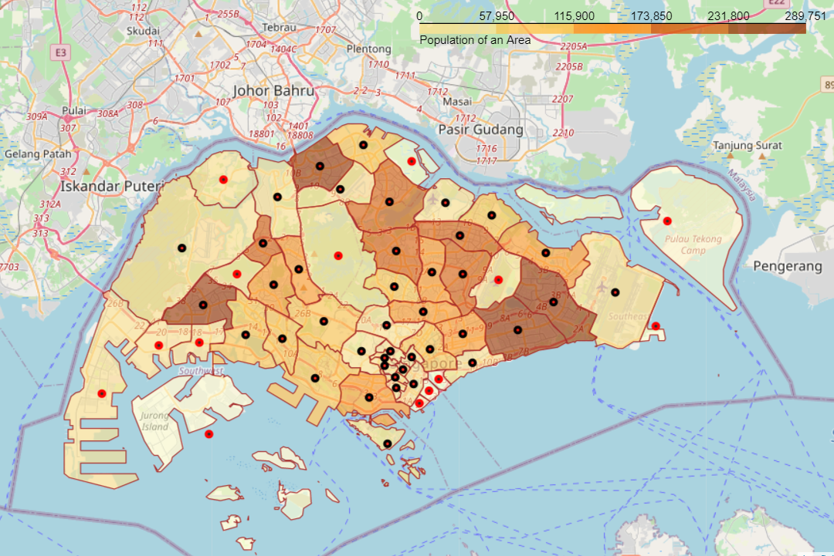
Singapore Population Distribution
most people are staying in this area

Slide 6
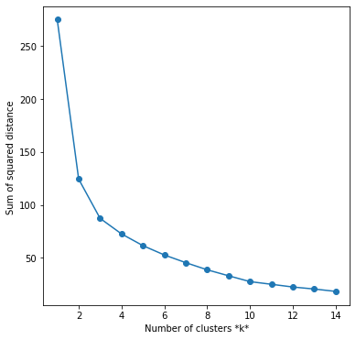
K Means Clustering
Use to group similar clusters together. Sum of squared distance ( Inertia ) is used to determine suitable number of K to be used for this dataset.
The lower the value of inertia, the better it is as it means intra-cluster distance is lesser. ( items within clusters are more similar to one another )
Using the elbow method, K is set to be 3 for this particular dataset

Slide 7
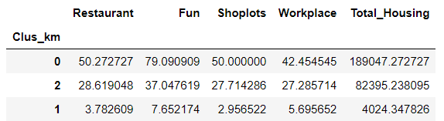
Information of Clusters
Clusters arranged according to mean descending number of restaurant in the area.
Cluster 0 will be further analyzed as it has most amount of restaurant per area. It also has highest mean on all 4 other categories.

Slide 8
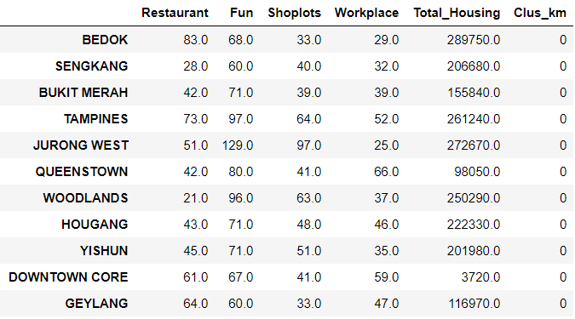
List of Areas within Cluster 0
6/10 Areas inside are within top 10 areas with most restaurant
7/10 Areas inside are within top 10 areas with most population
Woodlands, Sengkang have roughly 30% less restaurant than Queenstown, the next area with least restaurant
Woodlands and Sengkang is likely to be able to support few more restaurant with the current foot traffic that they have.

Slide 9
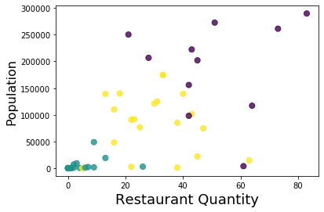
Other Findings
Scatter plot of Population against Restaurant Quantity shows that the two factors are not linearly proportional to one another.
Residential Area is not the only aspects that can provide foot traffic. Offices or pubs, cinemas or stadiums can also have an affect on foot traffic.

Slide 10
Conclusion
Woodlands and Sengkang is shown to have potential to be a good location for a restaurant due to its high foot traffic yet low competition.
More aspects can be included to see its effect on the model

